Slide 1
Comparison of Different Techniques for Fisheye Correction:
Computer Vision Mini-project
Eshaan Shah – 210962174
Ankit Kumar – 210962158
Pranay Jaju – 210962146

Slide 2
Introduction
In this mini-project, we compare two different techniques for fish eye correction:
Hemicylindrical Unwrapping
& Midpoint Circle Method

Slide 3
Hemicylindrical unwrapping

Slide 4
1. Calculating Vanishing Points
It’s a 4-step process
2. Estimating Distortion Center
4. Unwrapping Hemicylinder
3. Projecting onto hemicylinder

Slide 5
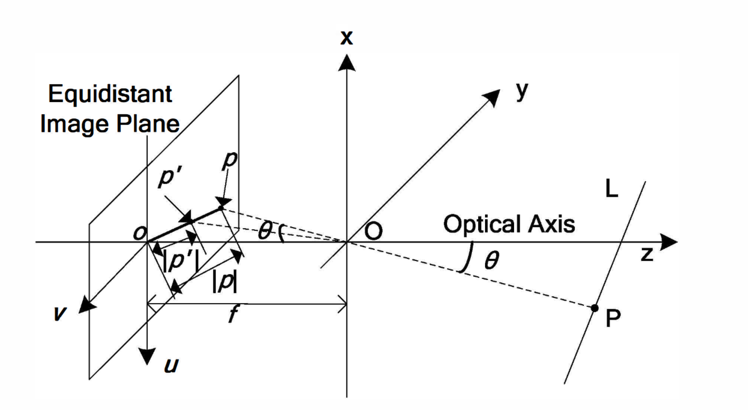
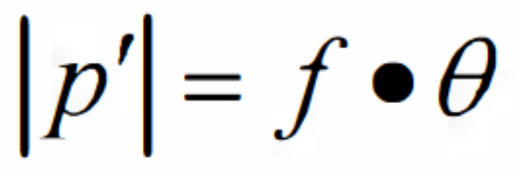
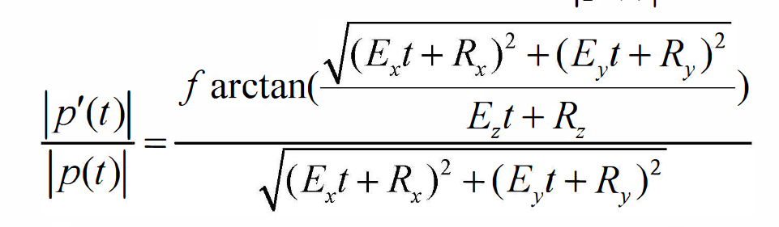
Assuming the projection to follows with the equidistant projection model, we can assume the relation
Using this relation, we can calculate the projection of two parallel lines found in the image (usually edges on a checkerboard) as follows,
and use their intersections as the vanishing points of the image plane.
1. Calculating the position of the vanishing points

Slide 6
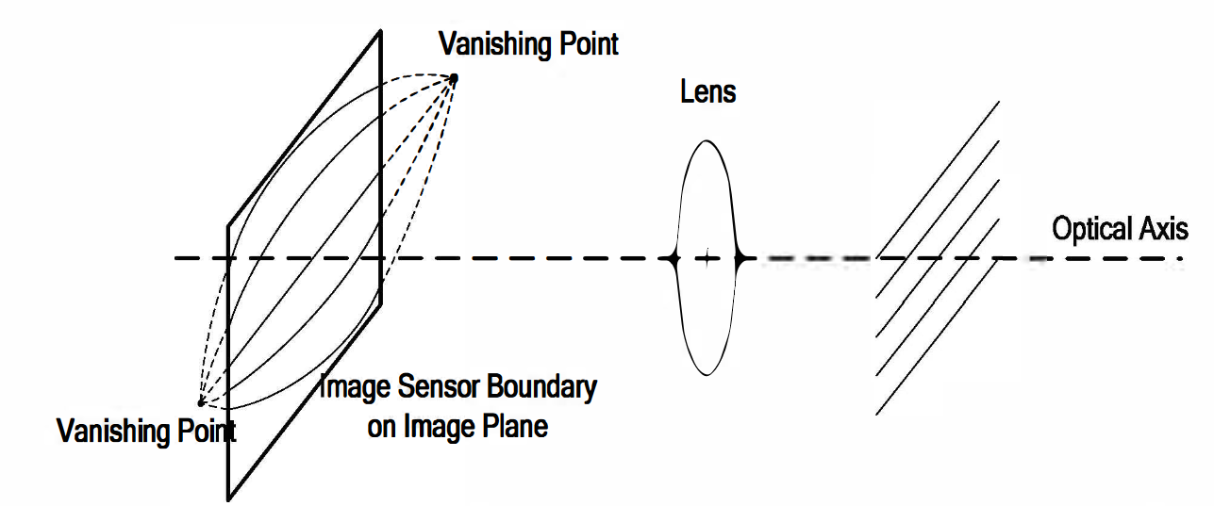
2. Estimation of the distortion center of the image
Using the vanishing points calculated in the previous step. It is possible to calculate the distortion center of the image. This is usually a point close to the center of the image, and in most cases can by easily estimated by taking the midpoint of the two vanishing points calculated

Slide 7
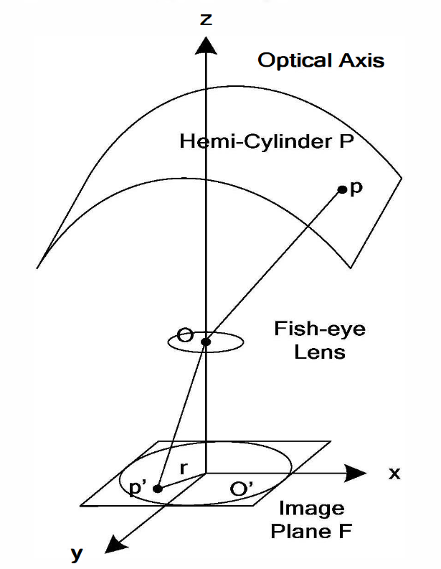
3. Calculate the projection mapping relation
Using the geometry of the hemi-cylinder, it is possible to calculate a mapping between the image plane and the hemicylindrical plane

Slide 8
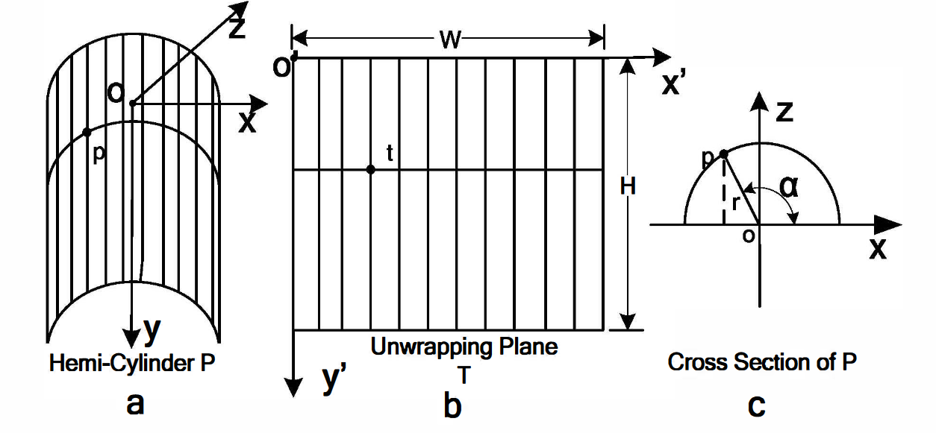
We can get a rectangular image by “unrolling” or “flattening” the image. Regular fisheye correction techniques suffer from a blowed up middle section and extremely condensed margins. By using a hemicylindrical projection of a direct rectangular one, we are able to reduce this effect to a great degree and obtain images that are a lot more comfortable for humans to read
4. “Unrolling” the hemicylinder

Slide 9
Midpoint Circle Method

Slide 10
1. Identify the Distorted Region
5-step process this time
4. Remapping Pixels
2. Circle Fitting
5. Interpolation
3. Calculate the Circle Parameters

Slide 11
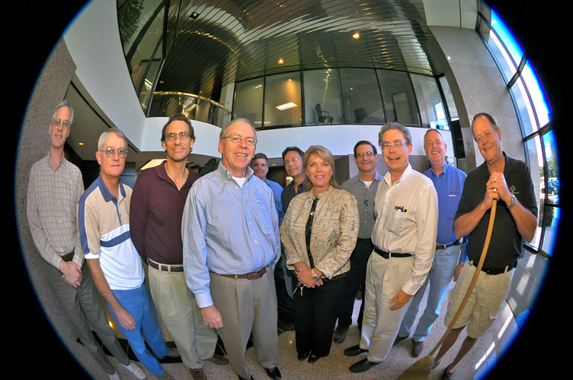
1. Choose the distorted region

Slide 12


2. Circle Fitting

Slide 13
3. Calculating circle params. Once the equation of the circle is found, it is easy to calculate its radius and centre for use in further calculations

Slide 14
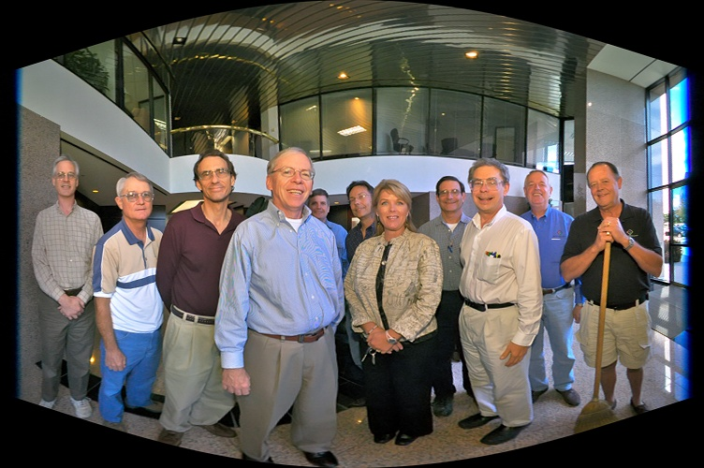
4. Remapping &
5. Interpolation

Slide 15
Conclusion

Slide 16
01
Accuracy
Overall, hemicylindrical performed better as compared to midpoint circle
02
Cross-domain applications
This technology can be potentially used in fields like surveillance, robotics, etc.
03
Content and geometry of image is presenrved
The images does not lose any important information and the relative geometry of points to each other is still maintained

Slide 17
Thank you!

